Slide 1
Project Work-2
Proctoring System

Slide 2
Overview

Slide 3
Abstract
Project Work-2 is a part of our 4th semester curriculum.
Project is a 2-credit course which is included to help students gain knowledge while working on a real time project. Project work include building a web/desktop based application applying skills of database management

Slide 4
Synopsis
We have decided to build a web-based application to maintain the proctoring system in the Department of Computer Science. The project helps in maintaining the records of students under different proctors and enabling online registration of students and helping the proctors to monitor the performance of their students online.

Slide 5
Motivation
We got this idea by seeing the mechanism of Proctoring System in our own college. This System is followed and maintained judiciously in our college. Proctors themselves spend time out of thier busy schedule to hold meetings and guide the students So, we decided to build a project that would provide a convinient online mechanism for the System

Slide 6
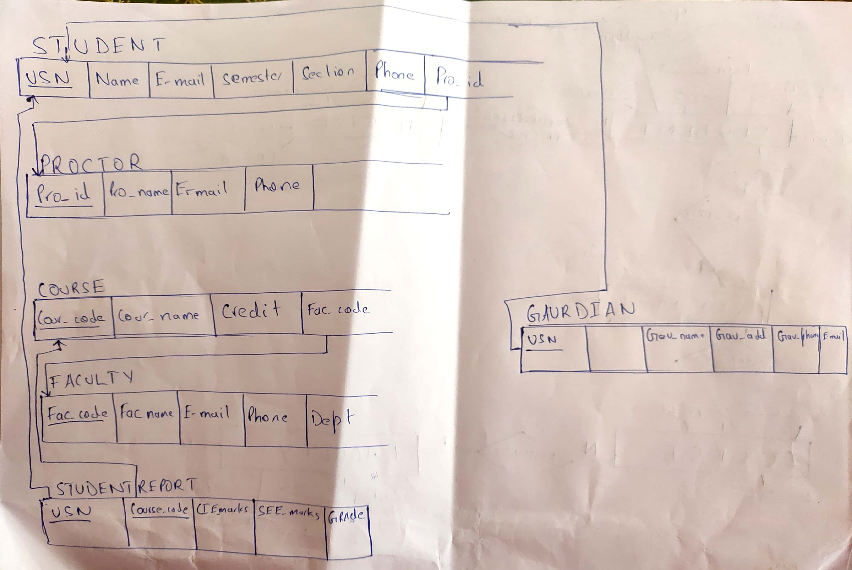
ER-Diagram

Slide 7
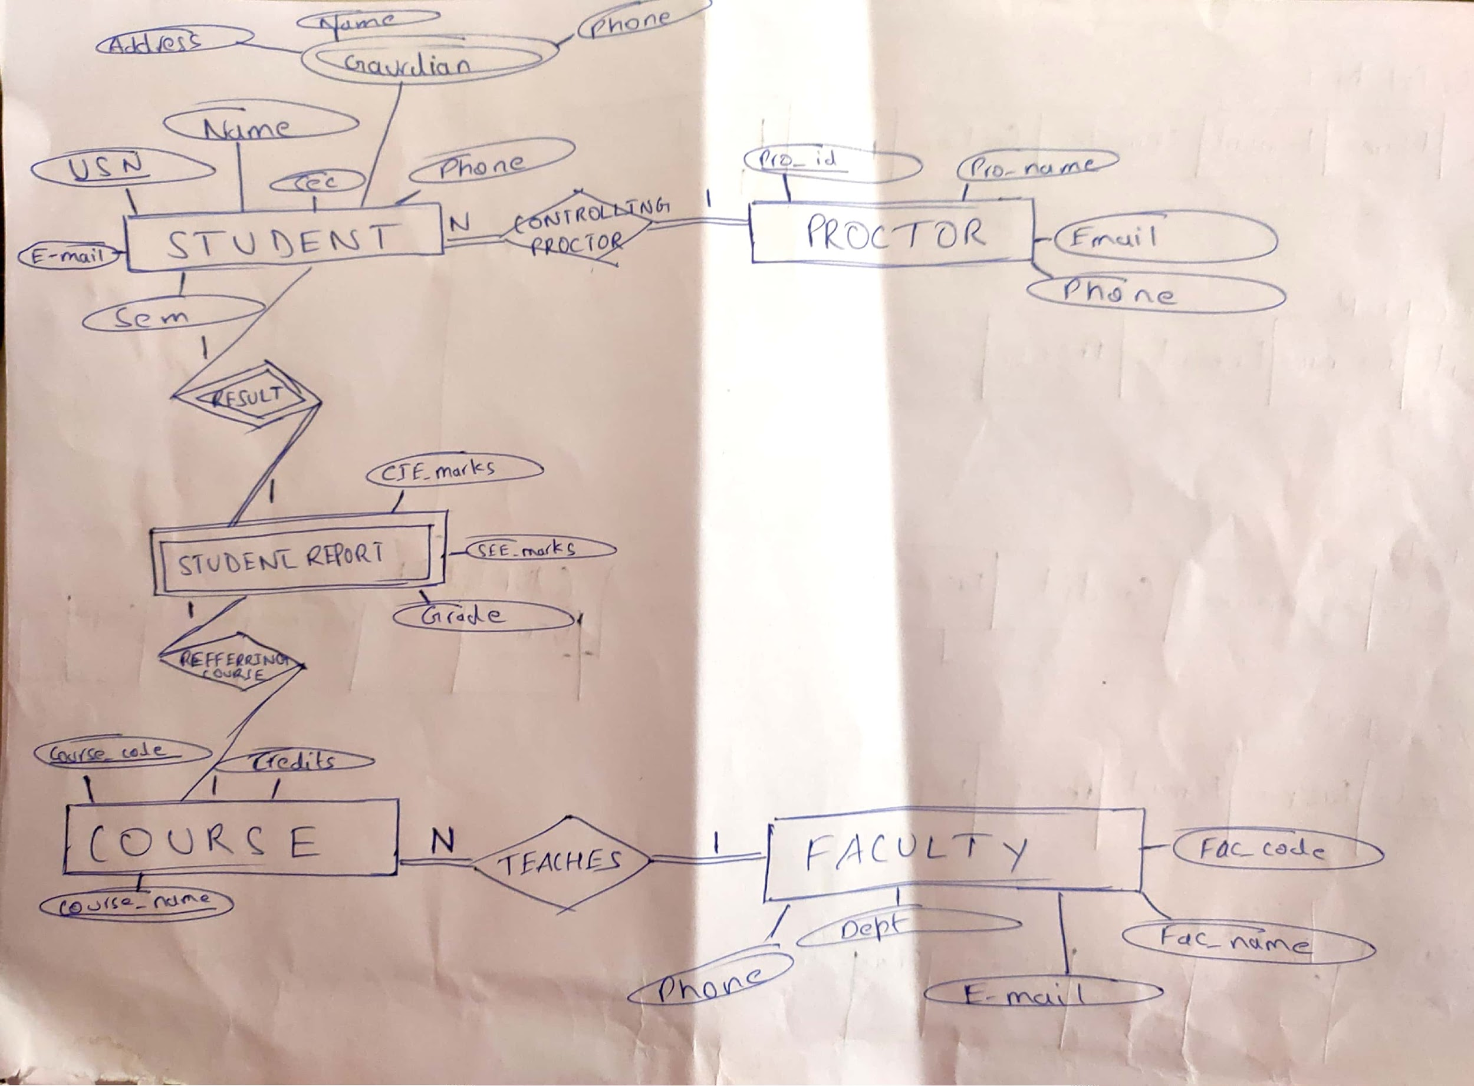
Relational schema

